Slide 1
DSL Productization
Anuparna Ganguly
18/08/2025

Slide 2
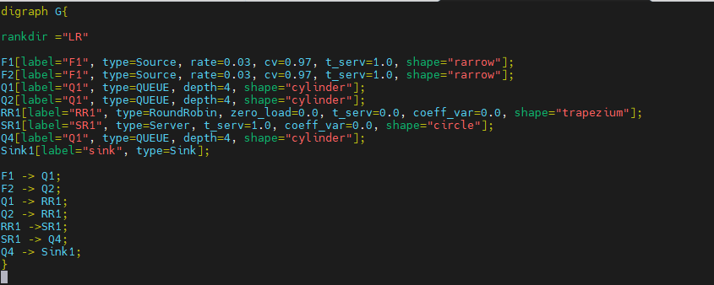
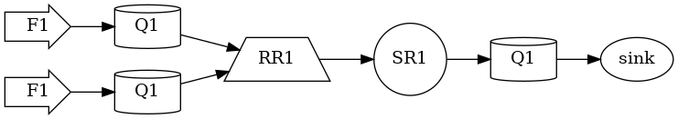
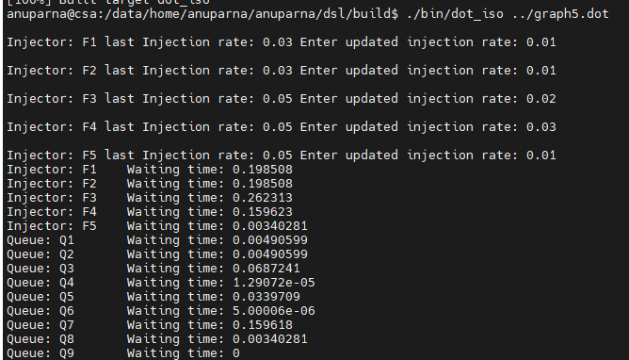
Working flow of the Tool
Input file: graph.dot
Dot_lang namespace
Final Execution
Graph figure
Read .dot file
Get node with attributes
Create the object of the corresponding class(based on type)
output
Put node and type into symbol table
Get Source and Destination
Parse Tree
Creating object of the class
Validate using Symbol Table
Dot
graph
digraph
id_ : G
{
stmt_list
stmt
id_ : rankdir
=
id_ : “LR”
stmt(node_stmt): F1
attr: rate = 0.03 attr: label= “F1\n[rate: 0.03]\n[CV2a: 0.97] “
attr: type = source
attr: cv = 0.82
attr: shape = rarrow
stmt(edge_stmt)
node_id : F1
edgeRHS
egdeop: ->
node_id: Q1
stmt(edge_stmt) : F2 - >Q2
F1
Class: Injector
Inj_rate – 0.03
Cv- 0.97
Q1
Class: Queue
depth – 4
Put it into data structure(map)
RR1
Class: RoundRobinArbiter
Zero_load – 0.0
Model namespace
Setting the Injection_rate & cv for injector
Symbol Table
Mapping
Start Execution in Forward direction
F1 => SOURCE
F2 => SOURCE
Q1 => QUEUE
Q2 => QUEUE
RR1 => ARBITER
SR1 => SERVER
map <string, shared_ptr<Primitive>> primitive_map;
map<shared_ptr<Primitive>, shared_ptr<Injector>> primitive_flow;
map<string, shared_ptr<Junc>> node_data;
If Sink gets full then recompute service time, injection_rate in Backward direction.
Again, execute in Forward direction
Calculate total waiting time of each injector

